Slide 1
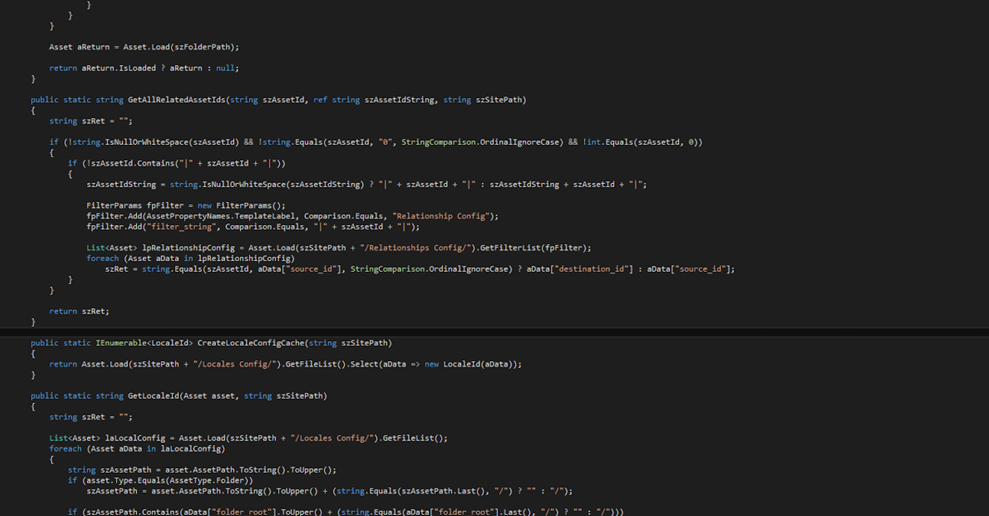
Dr. J. Patrick Desbrow Ed.D.
100 Day Plan

Slide 2
100 Day Plan
- Agenda
Presentation Agenda
A plan for your first 100 days on the job
A traditional view (a.k.a. what not to do)
Hit the ground running, but don’t break anything
Create a high level strategy
Develop a communication plan
Formulate action plans with milestones and timelines
Build high performing teams
Focus on the tactics. Execute, execute, execute…
Assess you successes and failures
100 day project plan

Slide 3
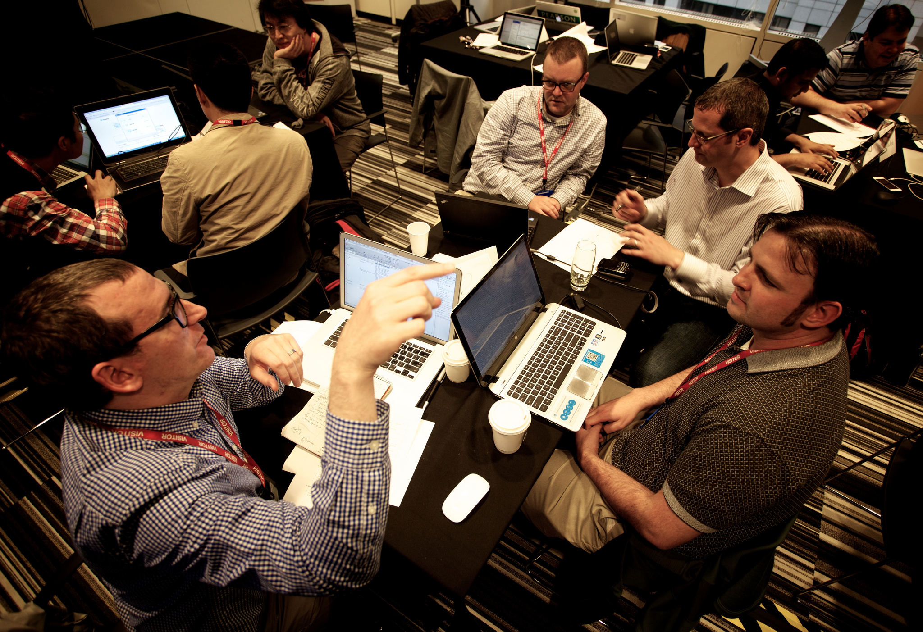

Section Overview
A Traditional View
Hit the Ground Running
Create a High Level Strategy

Slide 4
100 Day Plan
A Traditional View
A plan for your first 100 days on the job
Change the paradigm (buy verse build or visa versa)
Bring in new staff that is loyal to you
Reorganize the department just to show leadership
Look for quick wins to show progress
Meet with customers to find opportunities for change

Slide 5
100 Day Plan
Hit the Ground Running
A plan for your first 100 days on the job
Determine if the current environment or processes are broken on day 1
If yes, then base your 100 days on crisis management focusing on the areas that need the most attention
If not, take a broad based approach to learning the environment and current processes looking for opportunities for improvement
In either case, hit the ground running and make sure that these efforts do not break anything

Slide 6
100 Day Plan
Create a High Level Strategy
A plan for your first 100 days on the job
Determine if the current environment or processes are broken on day 1
Meet with key stakeholders by day 5
Review the current vision for the company
Understand what the mission statement means to you
Incorporate this shared vision into the planning
Develop a strategy based on a set of goals such as
Develop benchmark metrics for the IT group by day 30
Target legacy applications for sunset-ing by day 50
Improve software development group productivity by 20% by day 60
Reduce the cost of the IT infrastructure by 20% by day 90
Assess help desk services & improve response time by 50% by day 100

Slide 7


Section Overview
Communication Plan
Action Plans
High Performing Teams

Slide 8
100 Day Plan
Develop a Communication Plan
A plan for your first 100 days on the job
Develop a set of talking points by day 10
Embrace your company’s vision & mission statement
Address the important of IT in the organization
Acknowledge the current IT issues
Commit to improving the current environment
Inspire a future vision where anything is possible
Get out of your office and meet everyone by day 10
Conduct one-on-one meetings with entire staff
Meeting will all internal customers / key stakeholders
Meeting will all key external customers
Present your talking points in all meetings & other communications

Slide 9
100 Day Plan
Develop Action Plans
A plan for your first 100 days on the job
Translate the strategic goals into projects by day 30
Work with the IT project managers to create details plans for project
Chunk the projects into major & minor pieces
Ensure each plans includes key milestones and timelines
Review the current project execution by day 60
Migrate towards an agile methodology
Begin sprint design meetings and daily standups
Create greater transparency with product management

Slide 10
100 Day Plan
Build High Performing Teams
A plan for your first 100 days on the job
Review the current staff and organizational structure
Assess each person’s skill level (A,B,C)
Assess each person’s motivation and personal development goals
Present a future state vision that connects their personal goals with the company goals
Determine which staff members will following your leadership methods and techniques
Look for conflicts in the current team
Make the necessary changes to improve each of these

Slide 11


Section Overview
Focus on the tactics
Successes & Failures

Slide 12
100 Day Plan
Focus on the Tactics
A plan for your first 100 days on the job
Become personally involved in the key projects by day 10
Lead from the front by day 20
Demonstrate proper IT project management disciplines
Join the agile software development events including sprint design meetings and daily standups
Meet with key managers in development, QA, PMO and help desk on a weekly basis to inspire the teams and assess progress
Make adjustments when needed by 30
Change team assignments
Add or remove staff members if needed

Slide 13
100 Day Plan
Assess Success / Failure
A plan for your first 100 days on the job
Measure your progress against your goals
The benchmarks must be created by day 30
Start collecting data by day 30
Create reports that measure progress by day 40
Study your successes looking for patterns by day 60
Root cause your failures and repair them by day 60
Going forward review these results every 30 days and make the necessary adjustments quickly
Repeat this cycle every 50 to 60 days …

Slide 14
100 Day Plan
100 Day Project Plan
A plan for your first 100 days on the job
Day 1 through 20
Work with you to determine if the current processes are broken
Meet with you and other key stakeholders
Develop a strategy based on a set of goals
Develop a set of talking points
Get out of your office and meet everyone
Day 21 through 40
Translate the strategic goals into projects
Review the current staff and organizational structure
Review the current project execution

Slide 15
100 Day Plan
100 Day Project Plan
A plan for your first 100 days on the job
Day 41 through 60
Become personally involved in the key projects
Lead from the front. Then execute, execute, execute….
Make adjustments when needed
Day 61 through 80
Measure your progress again your goals
The benchmarks must be created by day 30
Start collecting data by day 30
Create reports that measure progress by day 40
Study your successes looking for patterns
Root cause your failures and repair them

Slide 16
100 Day Plan
100 Day Project Plan
A plan for your first 100 days on the job
Day 81 through 100
Going forward review these results every 30 days and make the necessary adjustments quickly
Repeat this cycle every 50 to 60 days …

Slide 17


Section Overview
Appendix

Slide 18
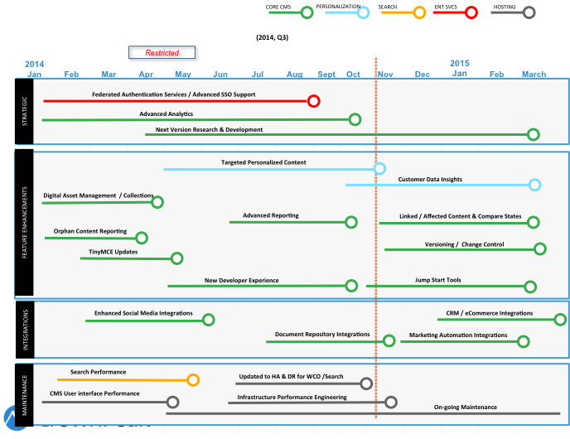
PRODUCT
- ROADMAP
Roadmap Themes
Strategic
Feature Enhancements
Integrations
Maintenance
Product Offerings
Content Management (CMS)
Personalization (WCO)
Search
Enterprise Services
Hosting

Slide 19
PRODUCT
- ROADMAP
Vision
Plan
Execute
Release






CMS
Personalization
Search
Hosting & Services
Publishing Monitor
Marketplace Integrations
Developer Experience
WCO in the CMS
New Version
Encrypted Data at Rest
Multi-Region support
Content Delivery Network
Auto-Scaling
Deep Monitoring
Non-Production hosting
DDOS testing
A/B Testing
Profiling Targeting Rules
Form Builder
Asset Level Reporting
Multi-byte support
Admin screens in Volte
Example results screen
Part of all new projects
Sample code to link to existing sites
Jump Start Tools
Import / Export Tools
Branching for Templates
Linked Content
Version Control
Database as a Service (DaaS)
Global Settings
Templates & Workflow
Host your Data
Developer applications
Connection string
Jump Start Tools
Next Version

Slide 20
Product
- Update
Developer Experience Improvements
RELEASED JUL
RELEASED OCT
RELEASED NOV
Visual Studio 2013 Integration
Debug & Profiler Tools
Separation of Environments
14
14
14
ETA FEB
ETA MAR
ETA APR
Jump Start Tools
Field Level
Dependencies
Import / Export Tools
15
15
15
ETA MAY
ETA JUN
ETA JUL
Version Control for
Templates &
Workflow
Branching for
Templates
Version Control for
Global Settings
15
15
15
Note: These dates represent a proposed schedule and are not an official commitment

Slide 21


Slide 22
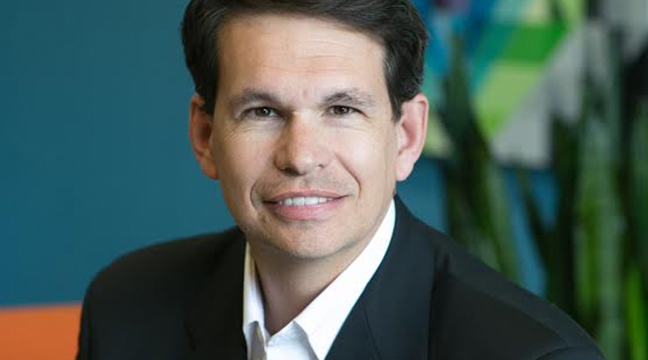
100 Day Plan
Dr. J. Patrick Desbrow, Ed.D.

